Slide 1

Lecture 01

Slide 2
Course Details
Objective
  Introduction to the field of Digital Image Processing, Study different algorithms and their applications in different areas.
Grading
  Midterm 30%
  Final 50%
  Assignments 10%
  Quizzes 10%
Books
  Gonzalez Rafeal C., Digital Image Processing, 3rd Edition

Slide 3
Prerequisites
This is a computer science course
  It will involve a fair amount of mathematics
    –calculus, linear algebra, geometry
    –probability
    –analog/digital signal processing
    –graph theory etc.
  It will involve the modeling and design of a real system
    –Programming skills with MATLAB, Python, or C++

Slide 4
Image
An image is a visual representation of an object, scene, person, or concept produced by various means, such as photography, painting, drawing, or digital creation.

Slide 5
Digital Image
A digital image is a representation of visual information in a digital form. It is composed of a grid of discrete picture elements, known as pixels, arranged in rows and columns. Each pixel contains information about color and brightness, which collectively form the visual content of the image.

Slide 6
Image Processing
Image processing is a method or technique used to perform various operations on an image to enhance its quality, extract useful information, or make it suitable for specific applications.
It involves manipulating digital images using algorithms and mathematical operations to achieve desired outcomes.
Digital image processing is widely used in various fields such as medical imaging, remote sensing, satellite imaging, photography, video processing, forensic analysis, industrial quality control, and computer vision.

Slide 7
Why do we need Image Processing
It is motivated by the following major applications
  Improvement of pictorial information for human perception
  Noise filtering
  Content enhancement (Contrast enhancement, De-blurring)
  Image processing for autonomous machine application
  Efficient storage and transmission

Slide 8
Major Topics
Image acquisition and digital image representation
Image enhancement
Image restoration
Color image processing
Image compression
Image segmentation
Morphological image processing
Special topics on recent progresses on digital image processing

Slide 9
Image Processing and Image Analysis
Low Level
Middle Level
High Level
Image acquisition
Image enhancement
Image compression
Image segmentation
Object recognition
Scene understanding
Semantics
Image Processing
Image Analysis
Computer Vision
Pattern Recognition

Slide 10
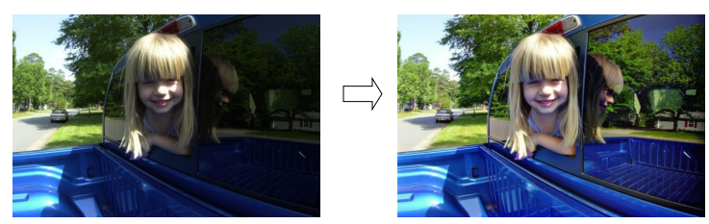
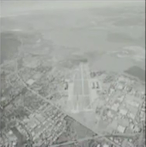
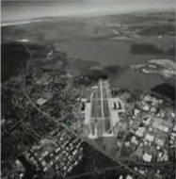
Image Enhancement
Low contrast image
Enhanced image

Slide 11
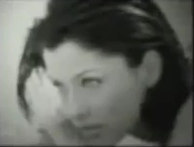
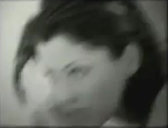

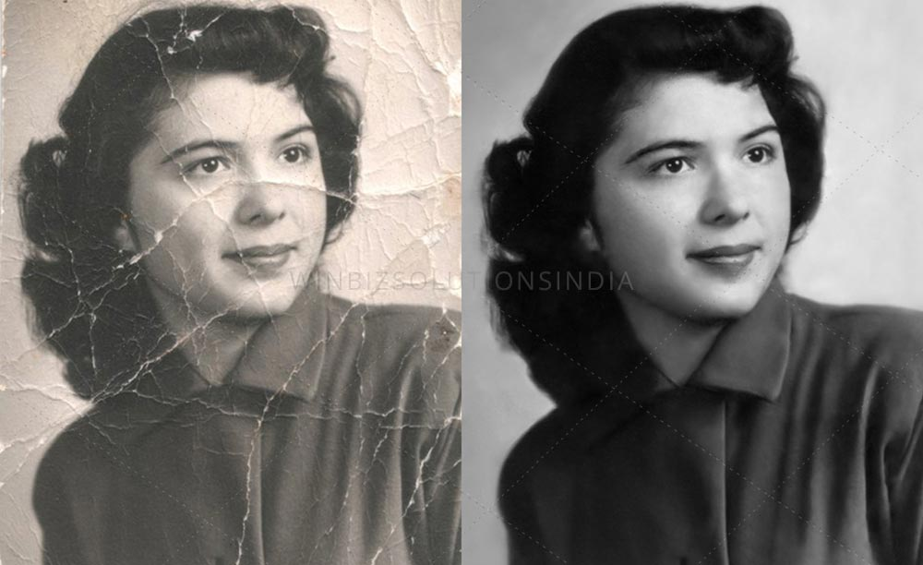
Image Restoration
Defocused image
Motion Blurred
De-blurred image

Slide 12
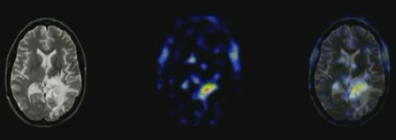
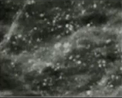
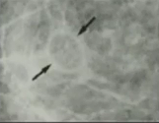
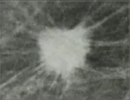
Medical Imaging
Brain Tumor
Cancer Detection

Slide 13
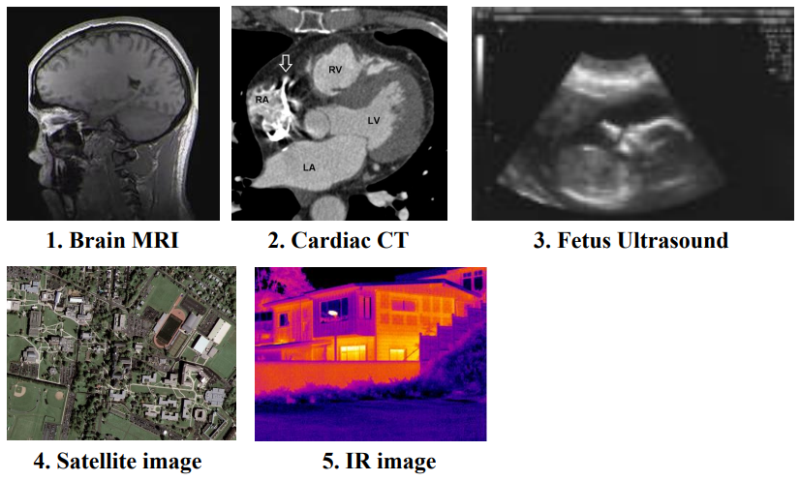


Slide 14
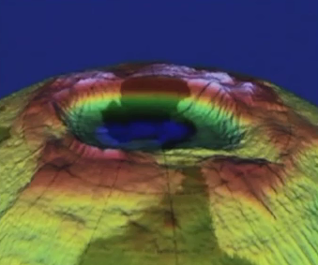
Atmospheric Study
Ozone hole

Slide 15
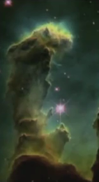
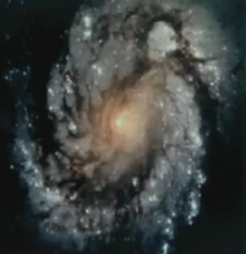
Astronomy
Galaxy
Star formation

Slide 16
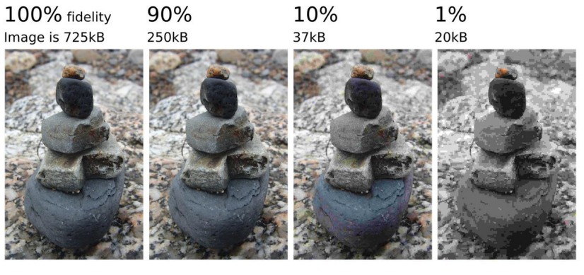
Image Compression

Slide 17
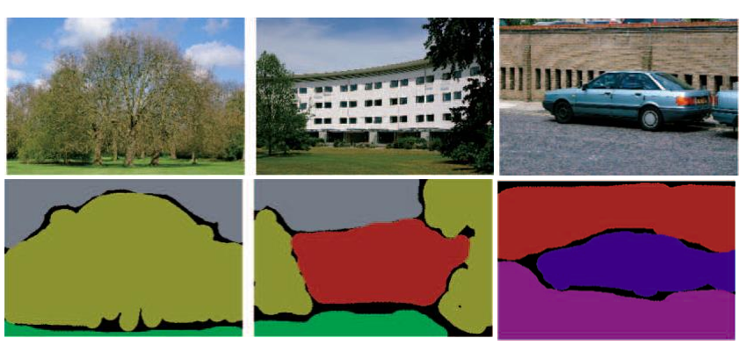
Image Segmentation

Slide 18
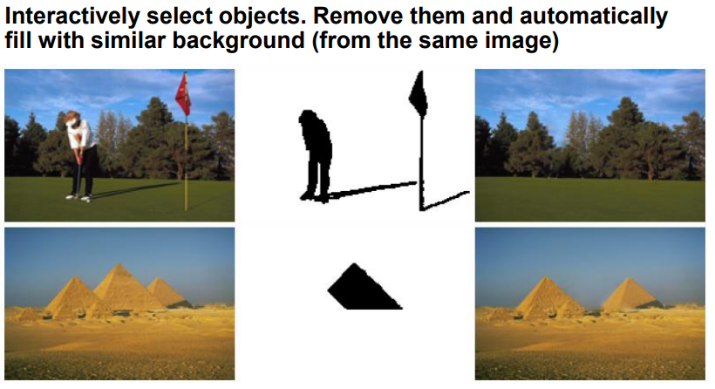
Image Completion

Slide 19
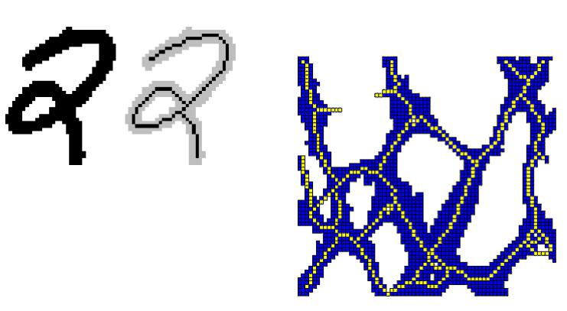
Morphological Image Processing

Slide 20
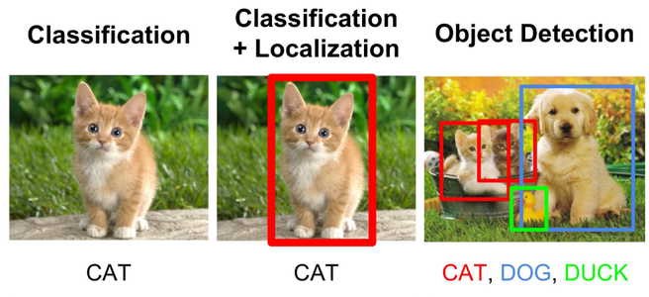
Object Detection / Recognition

Slide 21
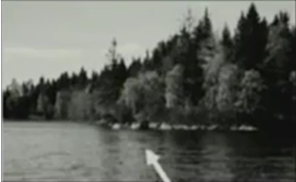
Image Representation
An image is a 2-D light intensity function f(x,y)
A digital image f(x,y) is discretized both in spatial coordinates and brightness
It can be considered as matrix whose row, column indices specify a point in the image and the element value identifies gray level value at that point
These elements are referred to be as pixels or pels
x
y
f(x,y) = r(x,y)*i(x,y)

Slide 22
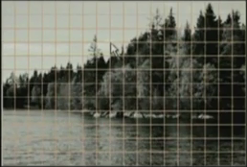
Image Representation
Spatial discretization by grids
Intensity discretization by quantization

Slide 23
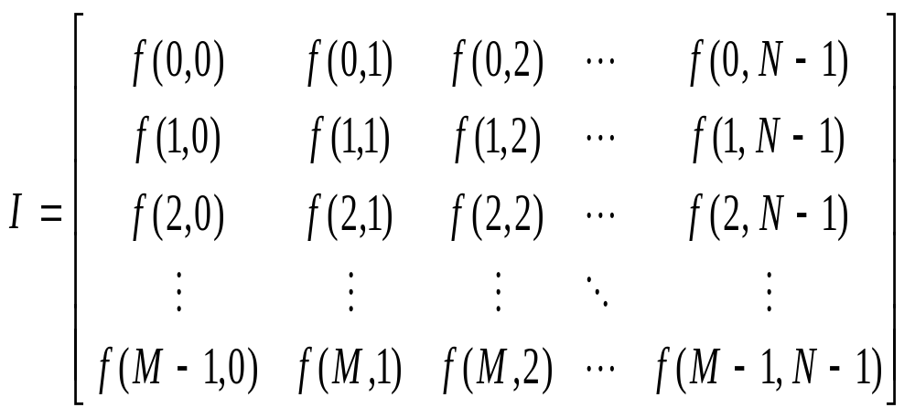
Image Representation

Slide 24
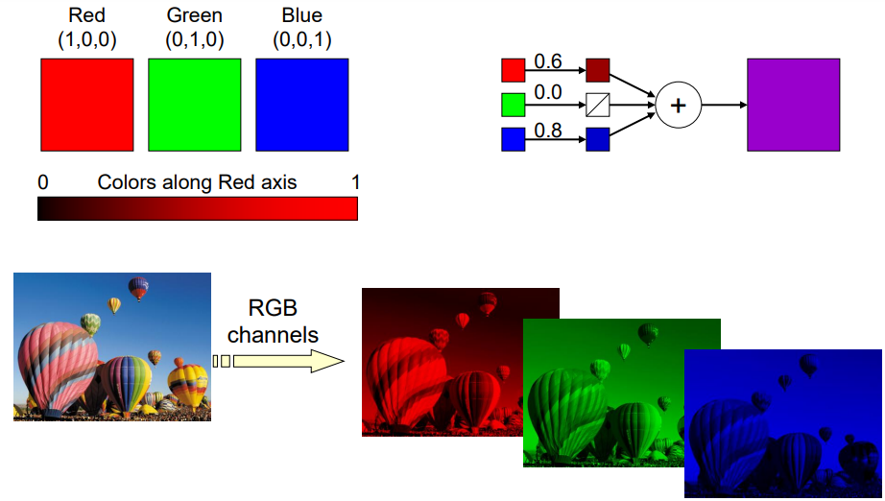
Color Image

Slide 25
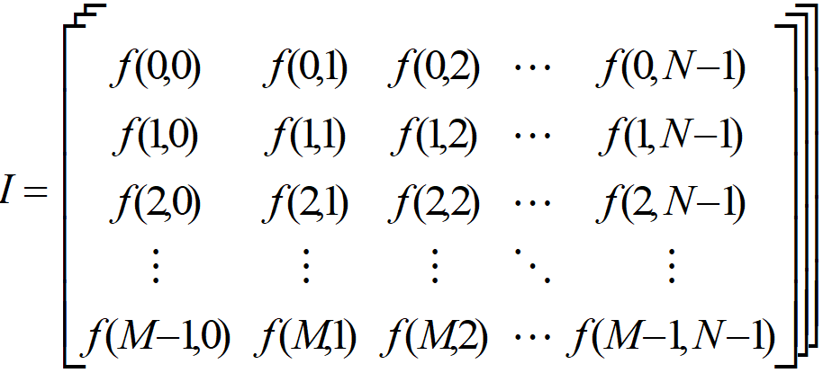
Color Image Representation

Slide 26
Digital Image Processing Steps
Image Acquisition
Preprocessing: Enhances the image quality, filtering etc.
Segmentation: Partitions an input image into constituent parts of objects
Feature Selection: Extracts description of image objects suitable for further processing
Recognition: Assigning a label to the object based on the information provided.
Knowledge Base: Learnt knowledge is stored for later use

Slide 27
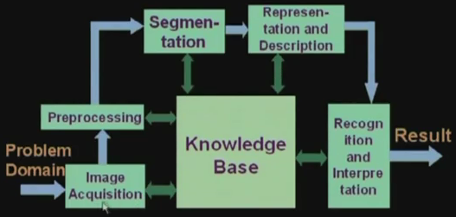
Digital Image Processing Steps

